Slide 1
Social Media platform (ZAA)
Team # 7
SIC 501 Coding & Programming Track

Slide 2
Welcome

Slide 3
"Success is not in what you have, but who you are." - Bo Bennett

Slide 4
TABLE OF Team Members
01
03
Facilitator
02
Ahmed Kamel
AbdAllah Ahmed
Zeyad Ehab
Eng.Ahmed Medhat

Slide 5
TABLE OF CONTENTS
01
03
02
04
Classes
Main code
Json files
Test cases

Slide 6
Classes
class project GUI(for login)
class Comment
class homepage
class new account

Slide 7
Json files
For login and register
For chat
For threads

Slide 8

CODE FLOW:
Stack
Login & register page
Home page
Json
Classes
Functions
User profile
Log out

Slide 9
Test cases

Slide 10
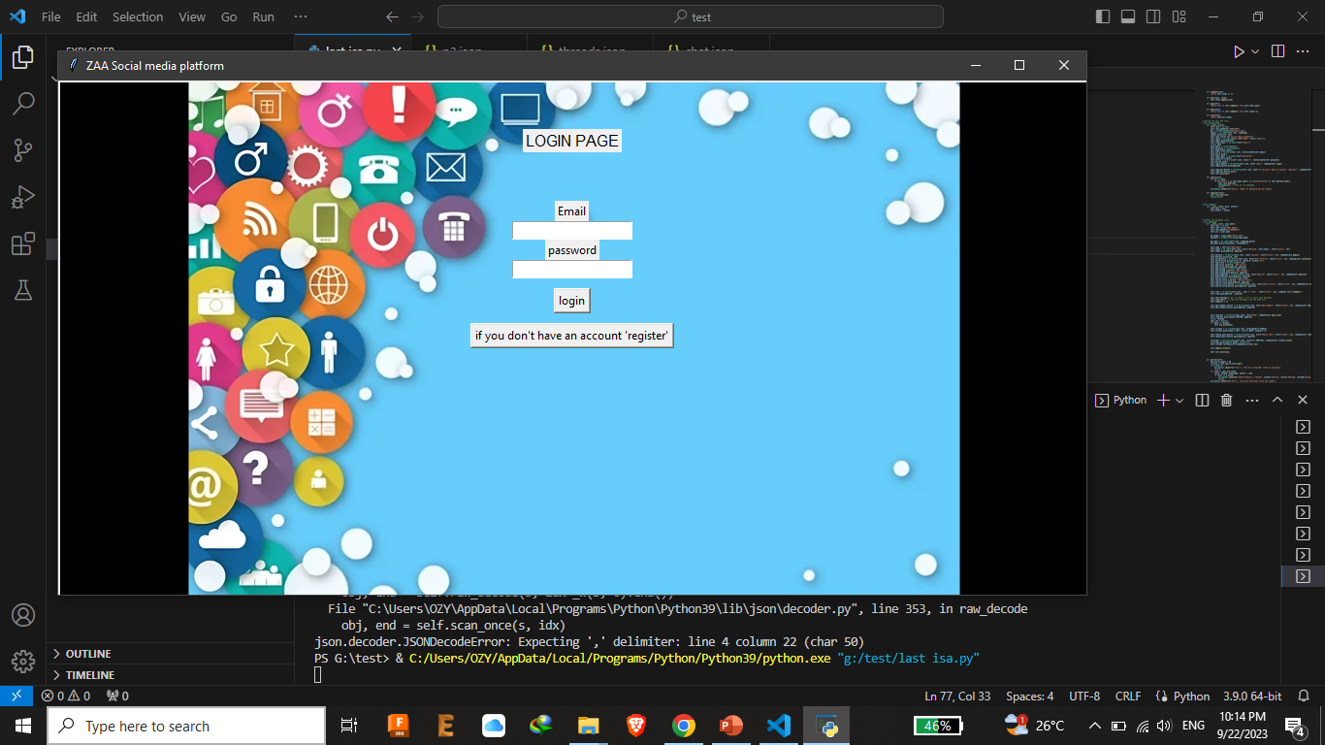
Application title
Entering the data

Slide 11
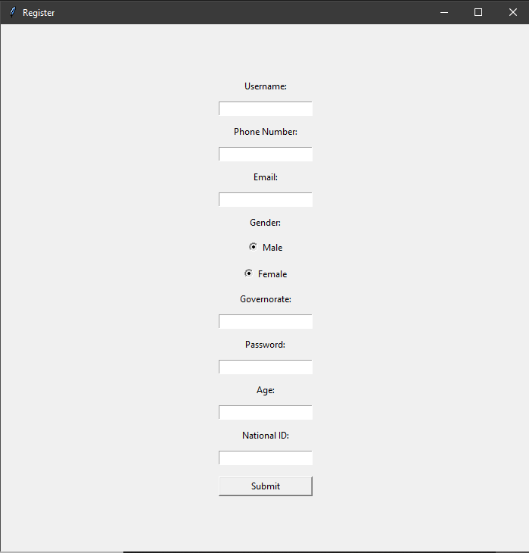

Slide 12
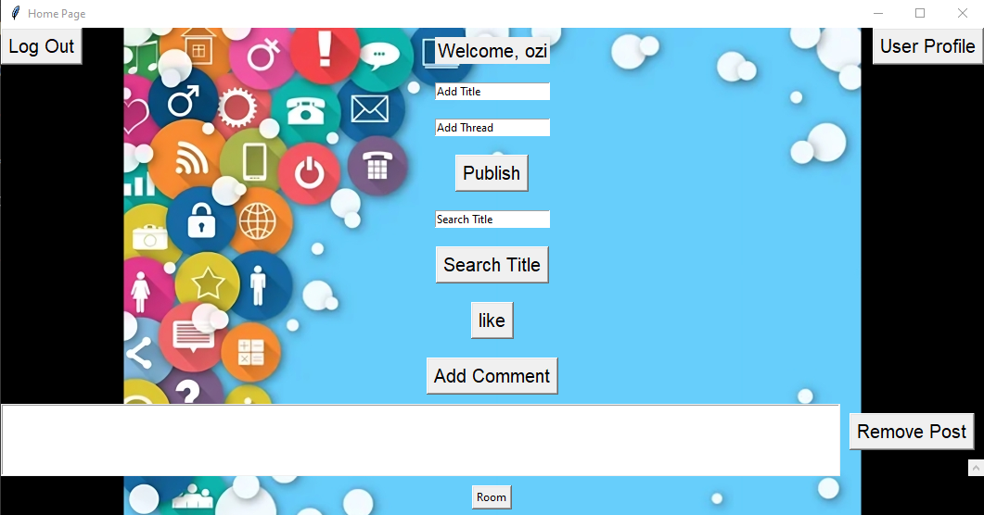

Slide 13
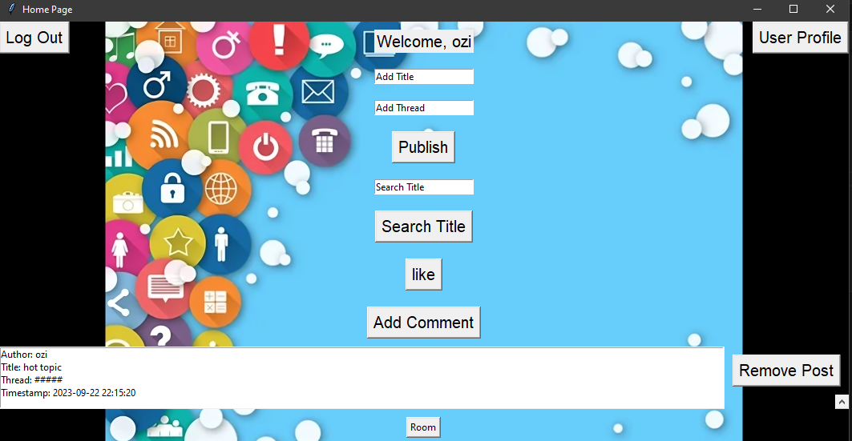

Slide 14
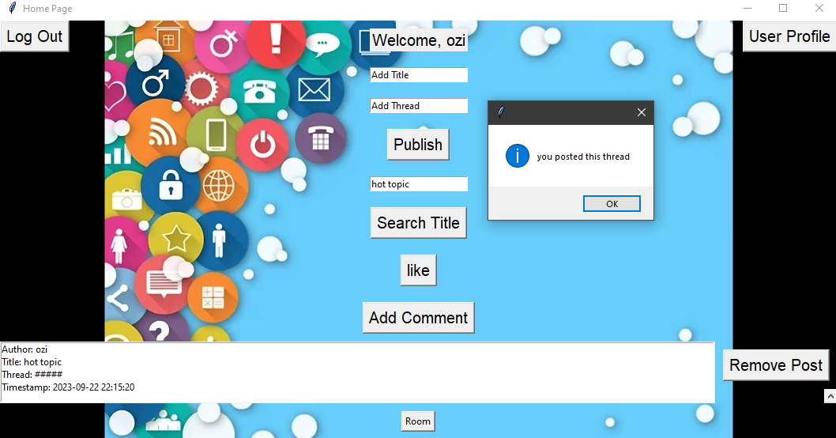

Slide 15
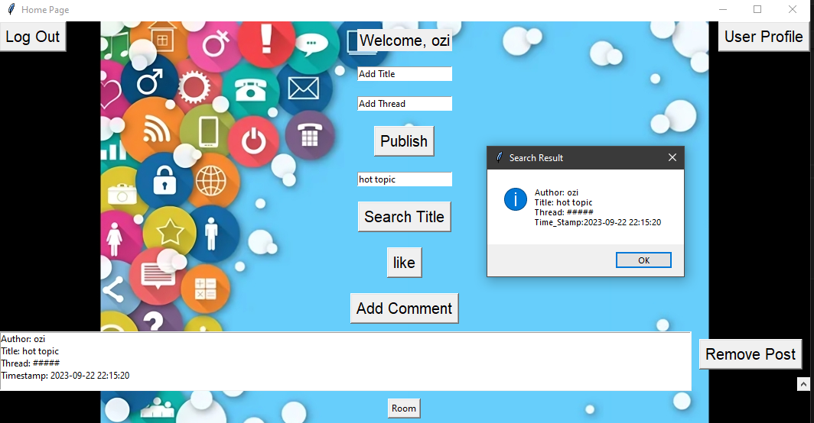

Slide 16
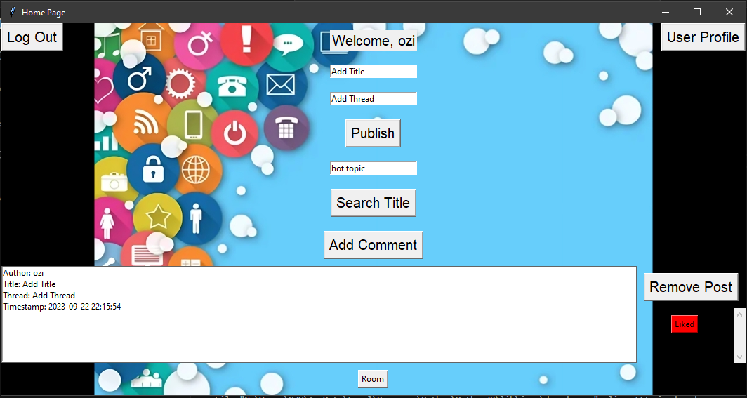

Slide 17
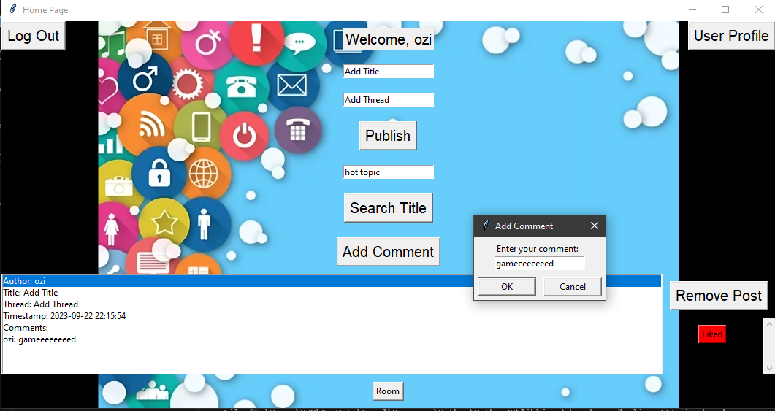

Slide 18
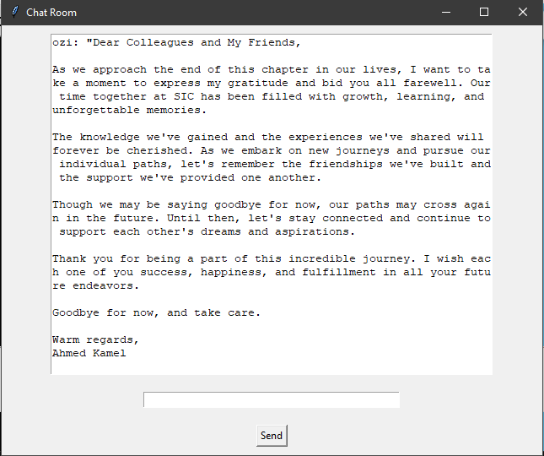

Slide 19
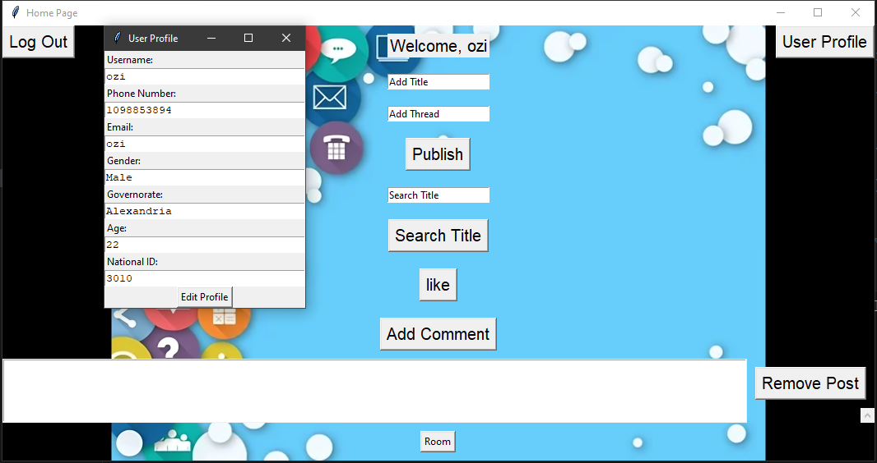

Slide 20
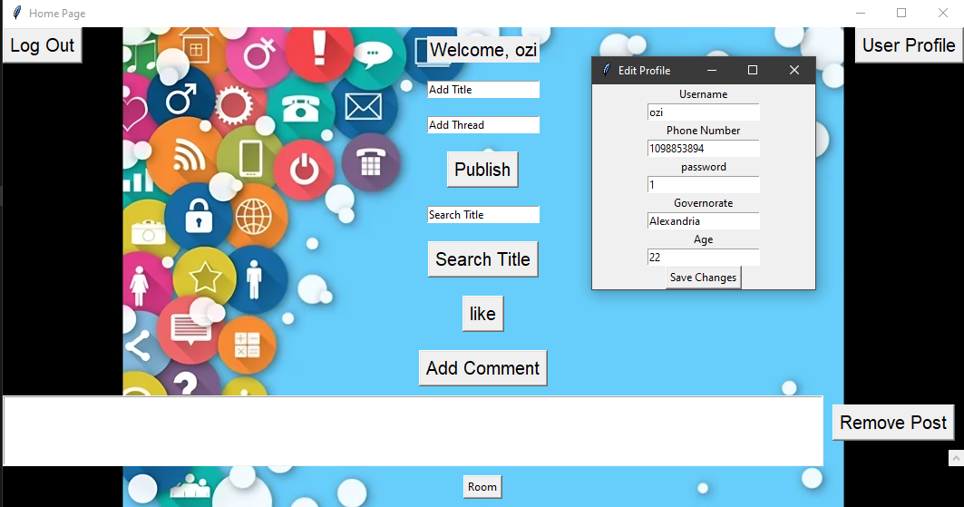

Slide 21
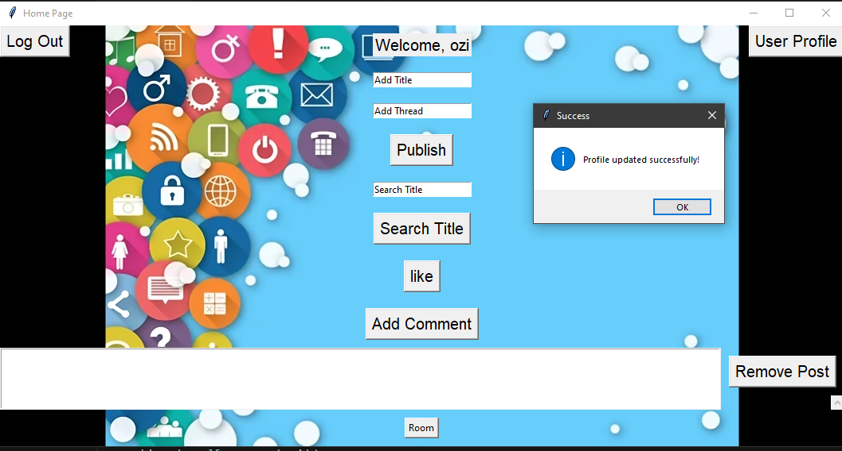

Slide 22

let's check code together
اتفرج اتفرررج

Slide 23
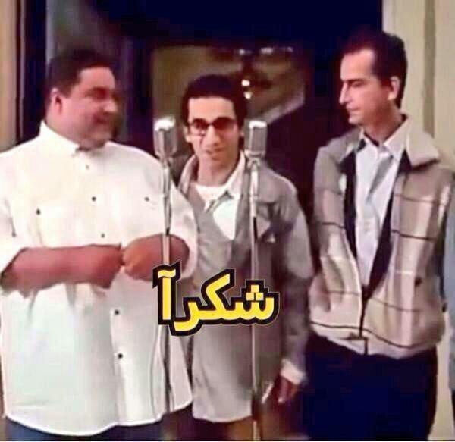
The End

